Slide 1
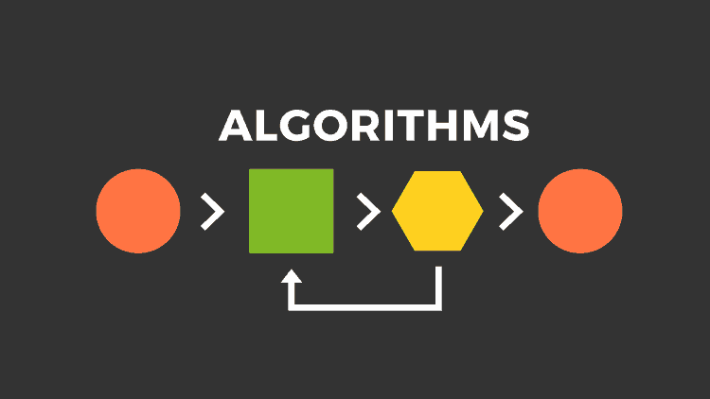
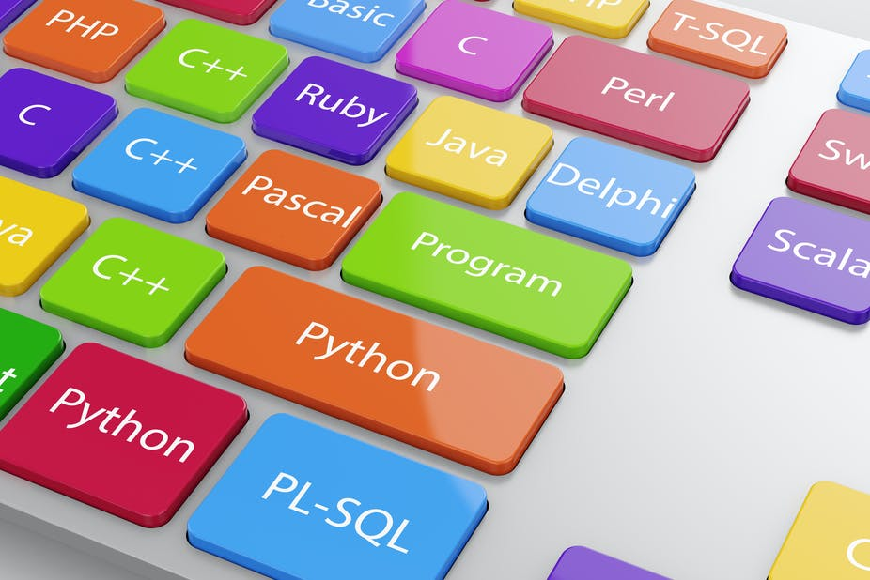
GIC Summer Training 2021
Algorithm & programming

Slide 2
Algorithm & C Programming
Content
Introduction to algorithm
Variable/Identifier
Introduction to C programming

Slide 3
Algorithm
What is an algorithm?
Algorithm is the step-by-step procedure that can help to solve a given problem or reach a goal.
To reach a goal, algorithm need input, process and output.
An algorithm is not compute code. It is just written in English or whatever the programmers speak. But it has a start, a middle and an end.
In order to make computer understand and solve the problem, algorithm is need to convert into specific computer programming language. Ex: C, C++, Python, Java…
Input
Process
Output

Slide 4
Algorithm
Why we need algorithm?
It gives us ideas to deal with the problems
It helps us to analyze a problem
It also tell us how to solve a problem
Important guideline
Clarity
Semantic: Meaning of the algorithm
Syntactic: Grammar (. ; “ ‘)

Slide 5
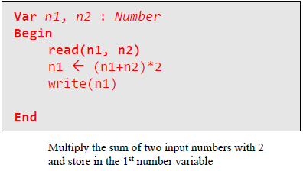
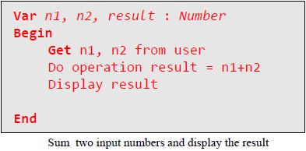
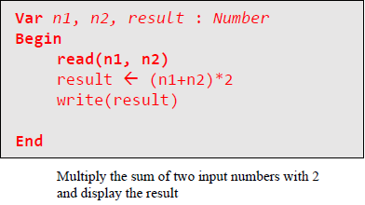
Some examples of algorithm

Slide 6
Variable/Identifier
A variable(identifier) is a holder of value which can be used for and changed throughout the program.
Variable is used to stored value and its value can be changed during program run.
X1 = 2*4000
X2 = 4*4000
X3 = 6*4000
A=4000
X1 = 2*A
X2 = 4*A
X3 = 6*A
What if the multiplier is changed to 5000?
So then, you need to change 3 times or more.
What if the multiplier is changed to 5000?
You just only need to change the value A.

Slide 7
Variable/Identifier
Basic type of variable
Number
Integer : A non-fractional number, ex: 1 3 4 5 6 …
Float : both fractional and non-fractional number, ex: 1.0, 2.6, 56.4 …
Character : A single letter. It is placed inside the single quote. Ex: ‘A’, ‘q’
Sequence of character : a set of letters. It is placed inside the double quote. Ex: “Sunday”, “apple” …
Note: Different types of variable consume different memory space.

Slide 8
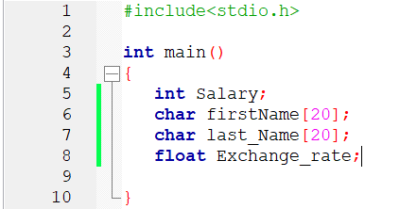
Variable/Identifier
Rule of naming a variable
Start with a letter (small or capital is okay) or underscore
Not start with number or any symbol
Space is not allowed
Variable cannot have the same name

Slide 9
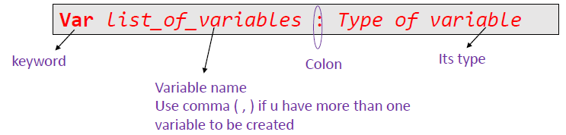
Variable/Identifier
Syntax to declare variable (for algorithm)
Example
Var age : Integer
Var name : Sequence of character
Var salary : Float
To get input from user in algorithm, we use instruction read
To display message or data in algorithm, we use instruction write

Slide 10
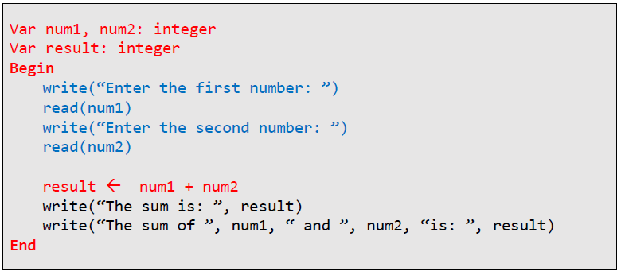
Example
Algorithm for adding input 2 numbers and display the result

Slide 11
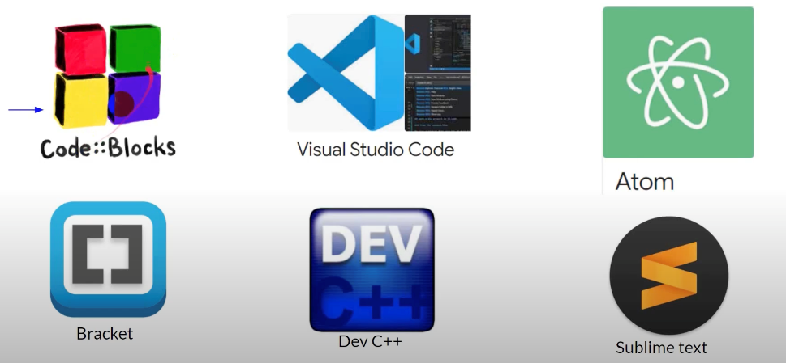
C Programming
An extension of C programming is .c
Before starting out in C program, make sure that you have compiler.
Compiler turns code that you write into an executable file that computer can understand and run.
Integrated Development Environment (IDE) is a software application that provides comprehensive facilities (code color, code completion, …) to computer programmers for software development.
Code block will be used
Other software that can use: Visual Studio Code, Dev C++

Slide 12
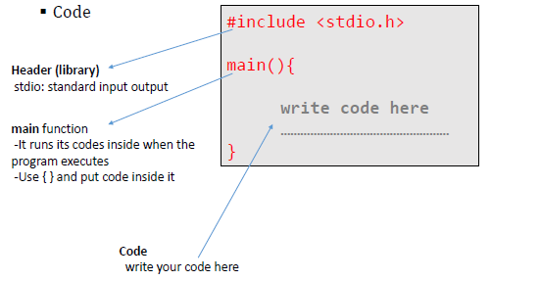
C Programming
Structure in C program

Slide 13
C Programming
Creating variable in C
int a,b,c; : Integer
float rate; : Float
char letter; : Character
char name[10]; : String (sequence of character)
Display the value of the variable
It requires placeholder
%d : for int
%f : for float
%c : for char
%s : for string
To insert special character, use the following inside double quote
\n : for new line
\t : for tab

Slide 14
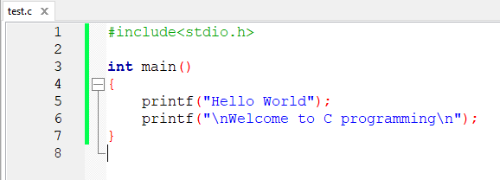
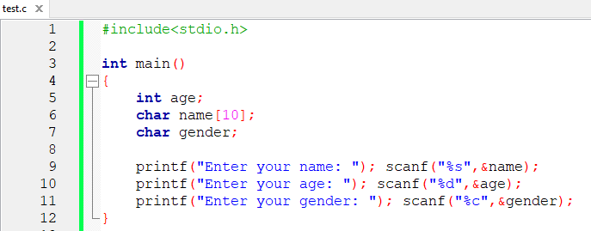
C Programming
To display any messages in C, we use command printf
To get input from user, we use command scanf

Slide 15
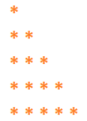
Exercise
Write C program to display:
Hello World! Welcome to C Programming !
Display star in form :
Write C program to read your firstname and your lastname from keyboard then display, “Welcome to GIC firstname lastname”

